Slide 1

Minor Project Progress Report “Malware Detection Using a Chatbot”
Abhilash Chutia [CSM23010]
Bishal Sharma [CSM23024]
Submitted to -
Dr. Dhruba Kr Bhattacharya
Professor
Ph.D (Tezpur University)

Slide 2
Agenda
Project Overview
Detailed Summary
Timeline
References
Summary

Slide 3

Project Overview
The goal of this project is to achieve an intelligent working Chatbot with the capabilities to consult an user through a series of questions at the end of which the Bot will be able to correctly identify if the user machine is infected by a malware and the type of malware.
By leveraging Natural Language processing, the bot is able to assist as a cybersecurity helper in identifying suspicious behaviour or indicator of compromise depending on the user inputs.
This project is a combination of chatbots, machine learning and cybersecurity.

Slide 4

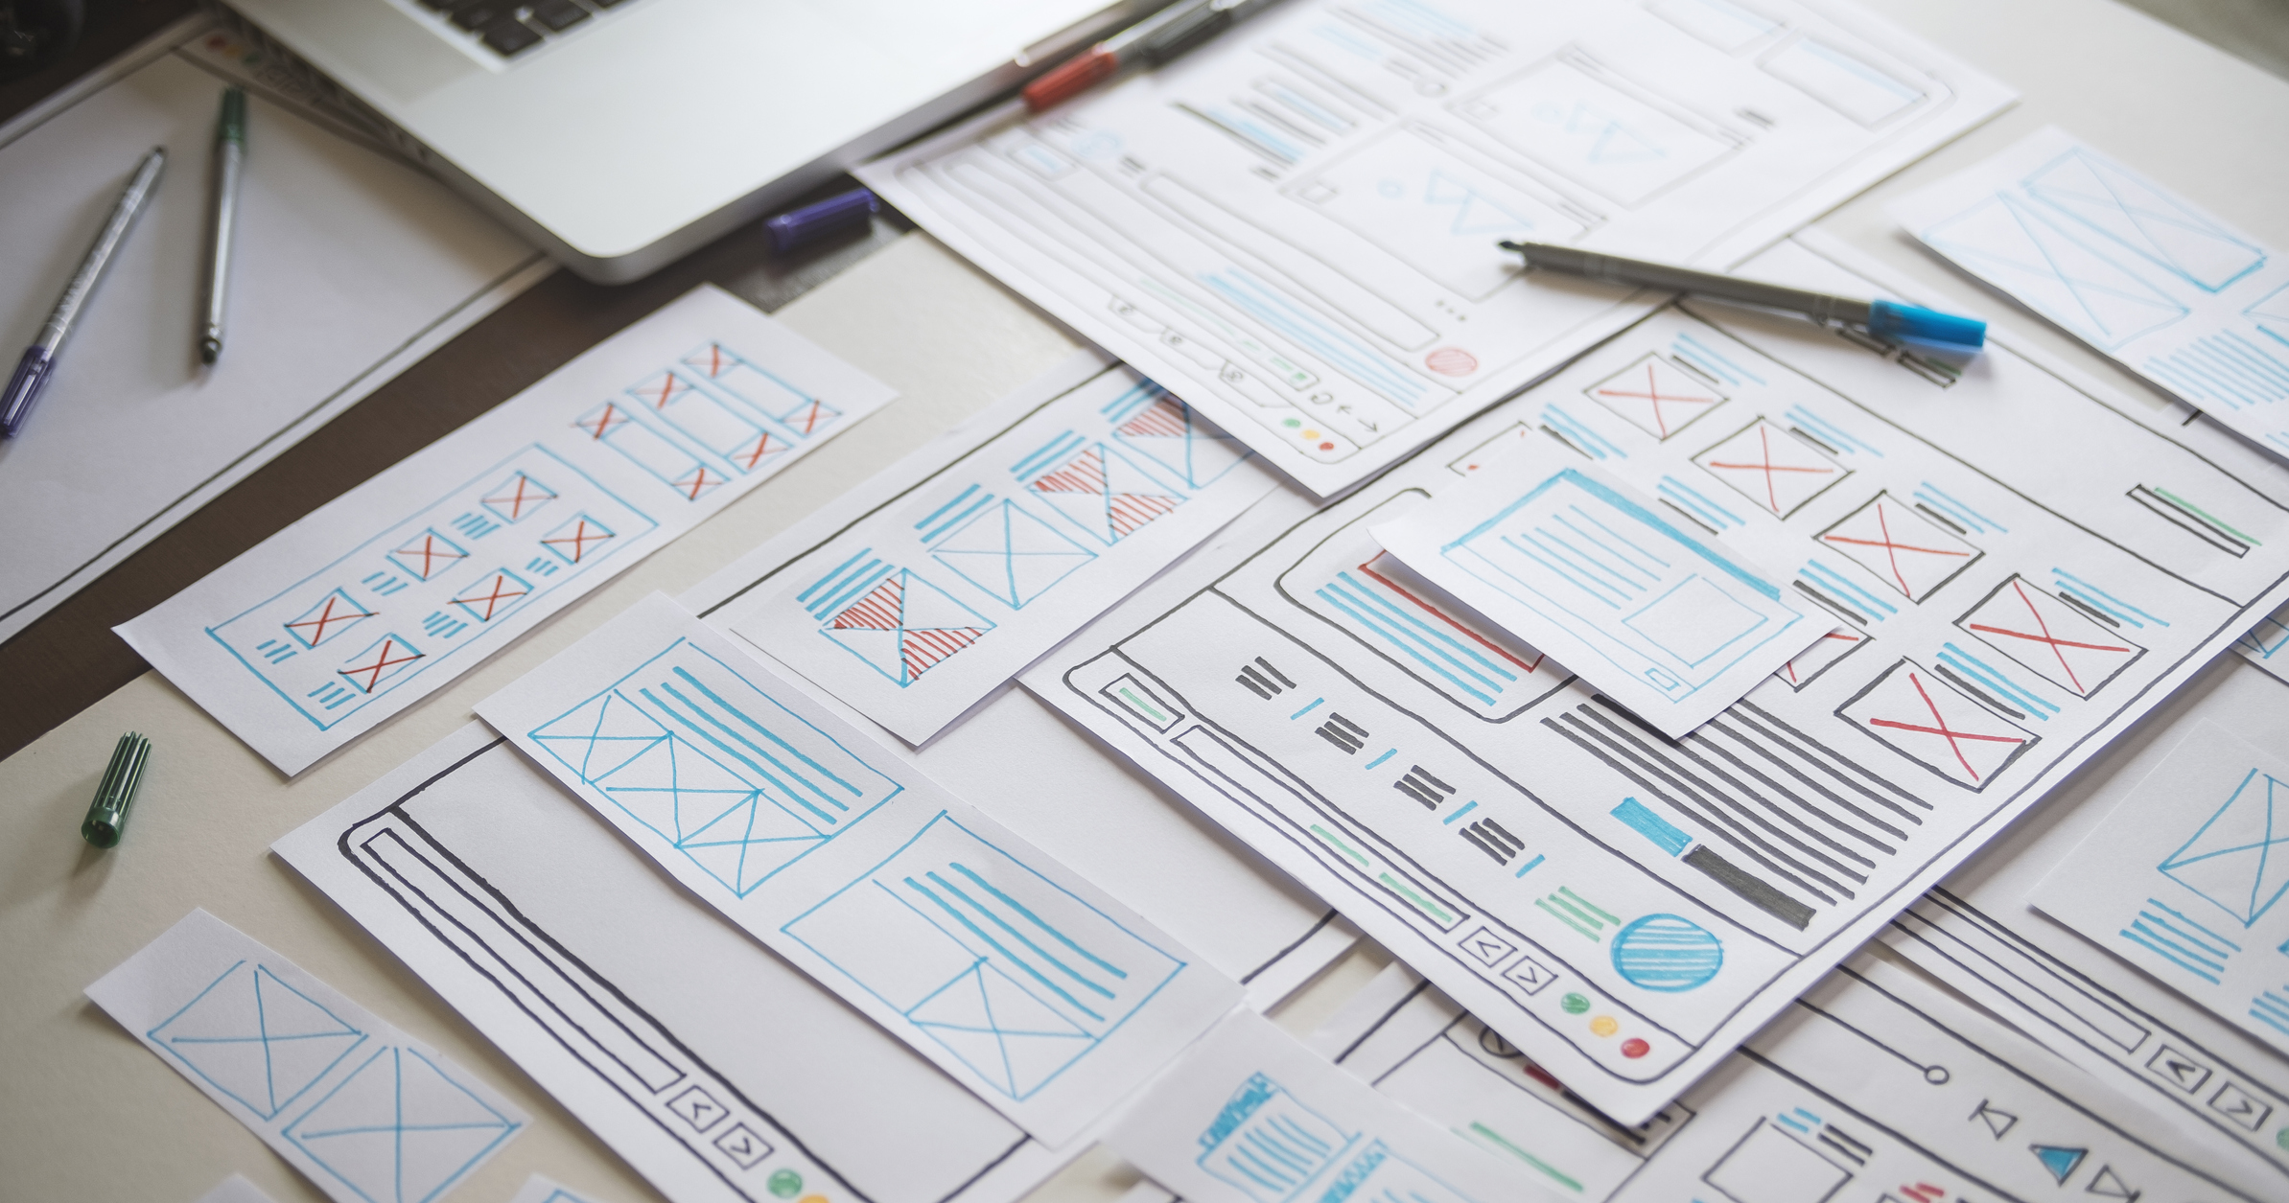
Detailed Summary
Malware Detection Chatbot

Slide 5
1. Presentation on Chatbots
This presentation covered the following topics:
1. What is a chatbot?
2. Types
Rule Based Chatbot
Open Ended Chatbots
3. Hardware/ Software Requirements
4. Python Libraries
Natural Language Toolkit [ntlk]
Transformers [Transformer Models]
Scikit-learn [Machine Learning Algorithms]
TensorFlow [Deep Learning Models]
Django [Web Interface]
5. Advantages
6. Use Cases
7. Challenges faced by Chatbots

Slide 6
2. Basic Chatbot
A basic chat bot has the following requirements to function:
1. A intents data file containing the interaction expected of the bot. This is in the form of a json file
2. Word Lemmatizer is used to reduce words to their base forms
3. Punctions are ignored
4. Words are extracted from the patterns and stored in a list called “Words”. Unique intent tags are stored in a list called “Classes”
5. The pickle library is used to save the vocabulary and classes for future use.

Slide 7
Model Training
1. TensorFlow’s Keras library is used to create a sequential model.
2. This model has two hidden layes with 128 and 64 neurons respectively. These layers extract features from the given data and learn about the complex relationships between the words and intents.
3. Dropout layers prevent overfitting of the training data.
4. The Stochastic Gradient Descent [SGD] is used to train the model.
5. The model is saved as “chatbot_model.h5” to be used again.
Libraries Used
1. Random
2. Json
3. Pickle
4. Numpy
5. TensorFlow
6. Ntlk

Slide 8
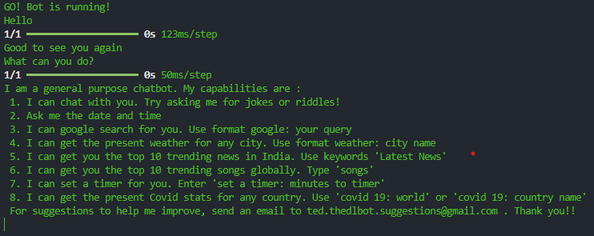
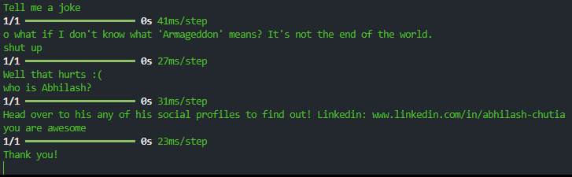
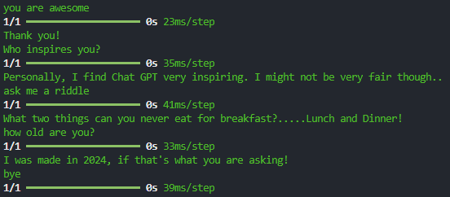

Slide 9
3. Presentation on Bias
This presentation included the following topics
1. What are Biases?
2. Types of Biases
Data Bias
Data Collection
Data Representation
Historical Bias
Selection Bias
User Interaction Bias
Algorithmic Bias
Presentation and Ranking Biases
Gender Bias
3. Impact of Biases on Chatbot
4. Strategies for mitigating Biases in Chatbots

Slide 10
4. Indian General Knowledge Bot
The libraries used here are:
1. Flask
2. OS
3. Google Generative AI
The chatbot is designed as a web application.
The users can interact with the bot by typing into a text field.
The Flask framework is used to handle user input and communication with the GenAI model.
GenAI Integration:
1. API key is configured to access the large language model capabilities.
2. Gemini 1.5 flash model is used for response generation, fluency and factual accuracy.
3. A chat session is initialized to provide a history of previous questions with the bot.

Slide 11
Flask Application:
A Flask application is created to handle web requests and responses.
Routing:
The root path is mapped to the index function which renders the interface Html template for the chatbot.
The ask path is mapped to the ask function which handles user interactions.
Overview:
The chatbot allows user to ask questions related to India. The Gemini Ai model utilizes it knowledge and understanding to generate the most informative response.
If the user asks questions unrelated to the topic of India, the model kindly lets the user know of its limitations and redirect the user to questions related to India.

Slide 12
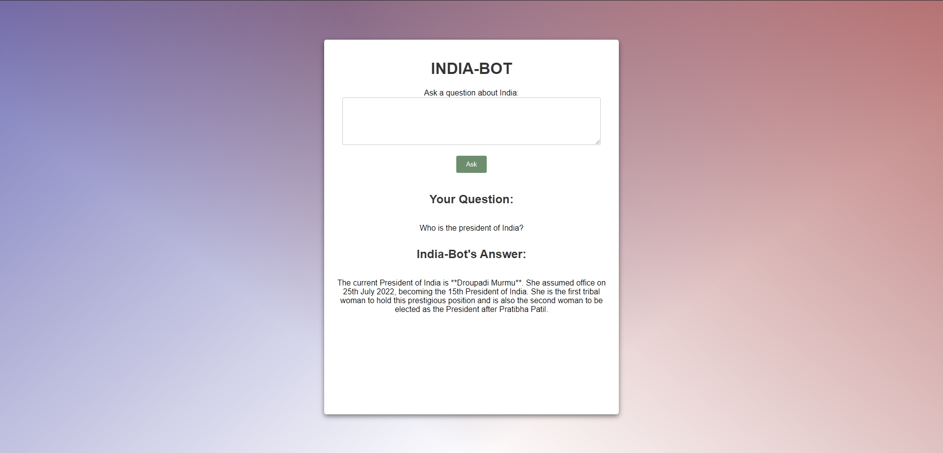

Slide 13


Slide 14


Slide 15
5. Presentation on Malware
The Presentation on Malware consisted of the following topics:
1. What is Malware?
2. Types of Malware
Viruses
Ransomware
Worms
Trojans
Spyware
Botnets
3. Signs of Malware infection
4. Steps to take on Malware Detection

Slide 16
6. Sherlock – The Malware Detective
The libraries used here are:
1. Flash
2. OS
3. Google generative AI
The chatbot is designed as a web application.
The users can interact with the bot by typing into a text field.
The user input is stored as history so that the the AI model can remember the context and generate appropriate responses.
The Flask framework is used to handle user input and communication with the GenAI model.
An API key is configured to access the large language model capabilities.
Gemini 1.5 flash model is used for response generation, fluency and factual accuracy.
A chat session is initialized to provide a history of previous questions with the bot.

Slide 17
Overview
Introduction:
The chatbot introduces itself as "Sherlock" and starts by asking questions about the user’s operating system and system setup.
Interactive Q&A:
Sherlock poses a series of questions to understand user symptoms, system characteristics, and any recent abnormal behaviour.
Symptom Analysis:
Based on user responses, Sherlock provides insights on whether the system might be infected.
Session Continuity:
Sherlock retains the chat history for a seamless conversational experience, allowing it to remember previous responses and build on them.
The "Malware Detection Using Chatbot" project provides an innovative, user-friendly way to assist individuals in identifying potential malware issues on their systems. This project demonstrates the potential of AI-driven tools to assist in cybersecurity awareness and initial malware assessment.

Slide 18
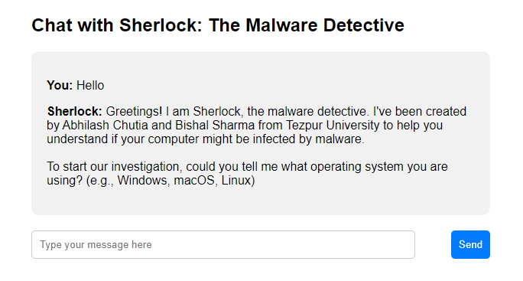
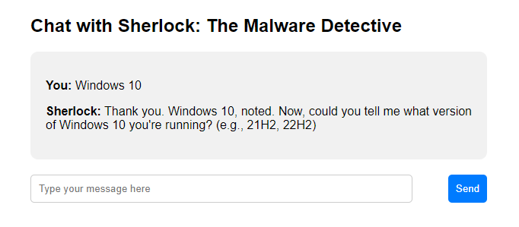

Slide 19
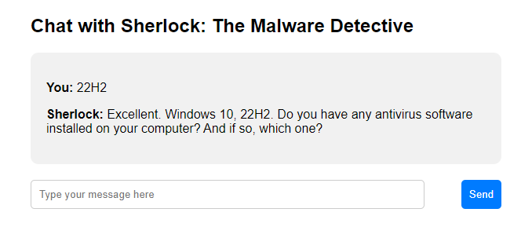
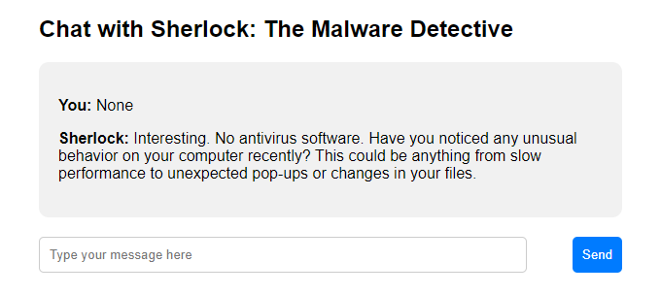

Slide 20
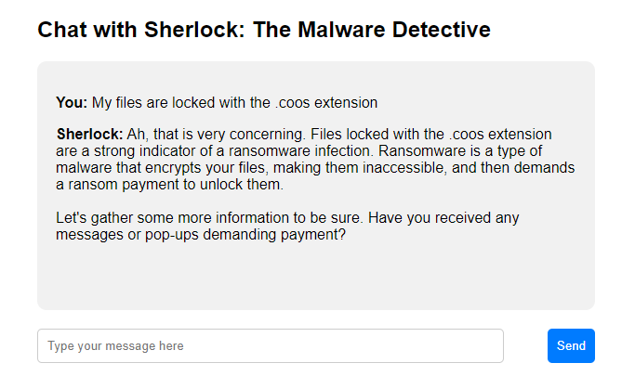

Slide 21
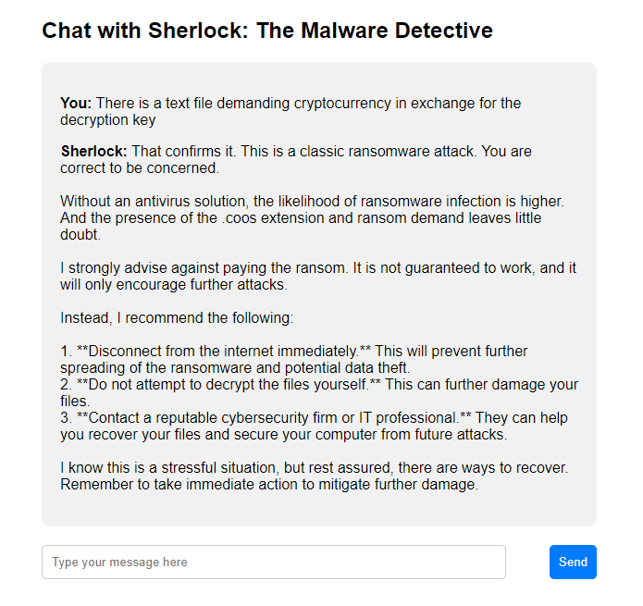

Slide 22





Timeline
Research on Chatbots
Implementation of a Chatbot
Bias Analysis
India General Knowledge Bot
Malware Detection Bot
Presentation on Chatbots, Types, advantages etc.
Simple Chatbot is implemented using Tensorflow
Presentation on Biases in Chatbots
Chatbot on Indian General Knowledge
Using Gemini API
Malware Detecting Chatbot using the Gemini API

Slide 23
References
Libraries and Frameworks:
Natural Language Toolkit (NLTK)
Transformers (Transformer Models)
Scikit-learn
TensorFlow (for model training) Flask (for handling the web-based chatbot)
APIs and Models:
Gemini 1.5 (for the Indian General Knowledge Bot)
Google Generative AI
External Sources:
Google Studios
https://ai.google.dev/gemini-api/docs/ai-studio-quickstart
Model Training
https://www.youtube.com/watch?v=hcaDOO1pMGE

Slide 24


Summary
The "Malware Detection Using a Chatbot" project, undertaken by use, Abhilash Chutia and Bishal Sharma under Dr. Dhruba Kr Bhattacharya, aims to develop a chatbot that identifies malware on a user’s system. This chatbot uses natural language processing to interact with users, helping detect suspicious behaviour that could indicate malware. Key stages of the project include:

Slide 25




Thank you
Abhilash Chutia [CSM23010]
Bishal Sharma [CSM2304]

